Slide 1
Report: Vector space IR model
Giảng viên hướng dẫn:
Nguyễn Trọng Chỉnh
Nguyễn Tuấn Lộc (18521011)
Dương Ngọc Hùng (18520792)
Hà Thúc Đăng Khoa (18520914)

Slide 2
Keypoint
Project overview
Document + Query Preprocess
Indexing + Retrieval process
Term weighting
Relevance Measure
Evaluation
Comparision

Slide 3
Overview
Build a vector space document retrieval model
Goal:
Learn the basic of building a simple IR model
Comparison the impact of lemmatizing and stemming

Slide 4
Settings
Python v3.8
Modules: nltk 3.5, json, math, os, numpy
nltk 3.5: famous natural language processing modules
json: storing index of corpora
math: performing math operation
os: directory reading
numpy: calculating cosine similarity

Slide 5
Dataset
Corpus: Cranfield corpus
Length: 1400 documents
Testing: 100 query with gold standards

Slide 6
Dataflow
Indexed file
Collection
CORPUS
IR SYSTEM
Indexer
Preprocessor
Query
Ranked ‘relevant’ documents
Searcher

Slide 7
Preprocess
nltk.stem.WordNetLemmatizer
nltk.corpus.stopwords
Lemmatize
Document
Tokenize
Stopwords removal
Result
Stem
nltk.word_tokenize()
nltk.stem.SnowballStemmer

Slide 8
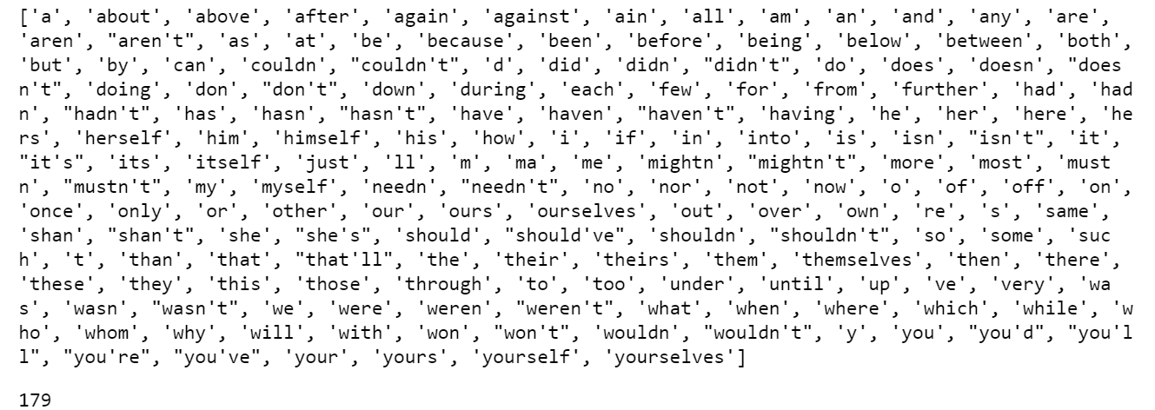
Stopwords Removal
Punctuation Removal (,.?’”:;)
nltk.corpus.stopword(‘english’)
Notes:
Chủ ngữ (I it he she…)
Chủ ngữ + trợ động từ (I’m, He’s…)
Từ nối (and, or, but, while…)
Giới từ (about, of, to,…)
Động từ: be, have, do.

Slide 9
Stemming
“your technique is outdated”
technique
outdat
your
techniqu
is
outdated

Slide 10
Lemmatization – pos tag
“your technique is outdated”
is
outdate
your
technique
be
outdated
PRP
NN
VBZ
VBN
Notes:
Prp: personal pronoun; nn: singular noun; vbz: verb; vbn: verb past tense

Slide 11
JSON
Javascript object notation: a data storing and exchanging format
Used for storing index of a corpus.
Syntax
{
<name1> : <value1>,
<name2> : [ <value2>, <value3> ]
}

Slide 12
Indexing
Corpus
Preprocess
id.json
Indexing
index.json
Directory
processed.json
id.json
{ <id> : <name>
<name> : <id> }
index.json
{ <term>:
‘posting’: <posting_list>
‘idf’ : <term_idf> }
processed.json
{ <id> : <processed content> }

Slide 13
Retrieval
processed query
Query
Preprocess
Index
Ranked
Result
index.json
query feature vector
relevant
document
and their feature vector

Slide 14
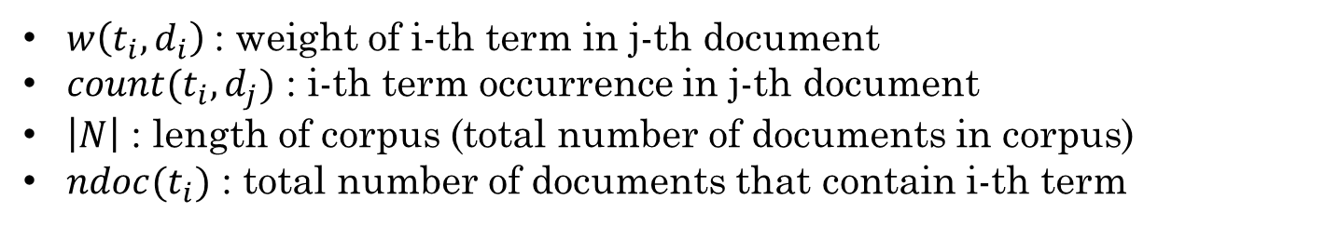
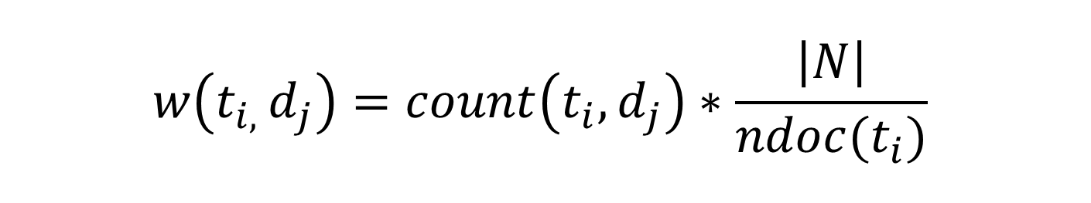
Term Weighting
$$w\left(t_{i, }d_{j}\right)=count\left(t_{i}, d_{j}\right)∗\frac{\left|N\right|}{ndoc(t_{i})}$$
$w\left(t_{i},d_{i}\right)$: weight of i-th term in j-th document
$count(t_{i},d_{j})$ : i-th term occurrence in j-th document
$\left|N\right|$ : length of corpus (total number of documents in corpus)
$ndoc(t_{i})$ : total number of documents that contain i-th term

Slide 15

Relevance Measure
$$\cos\left(q, d_{i}\right)= \frac{q∙d_{i}}{{|\left|q\right||}_{2}×{|\left|d_{i}\right||}_{2}}$$
$q$ : feature vector of query
$d_{i}$: i-th document in retrieved document

Slide 16
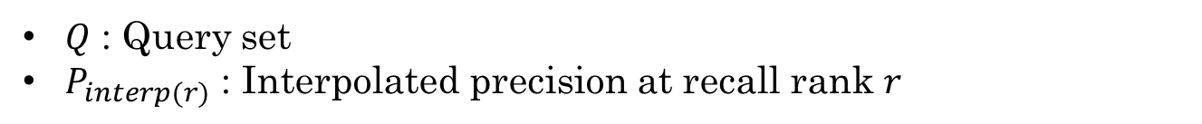
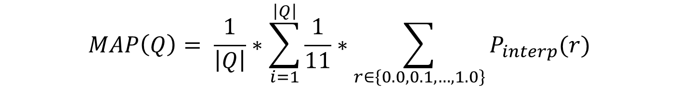
Evaluation
$$MAP\left(Q\right)= \frac{1}{\left|Q\right|}∗\sum_{i=1}^{\left|Q\right|}{\frac{1}{11}∗\sum_{r∈\left\{0.0, 0.1, …,1.0\right\}}{P_{interp}(r)}}$$
$Q$ : Query set
$P_{interp(r)}$ : Interpolated precision at recall rank $r$

Slide 17
Comparision

Slide 18
Conclusion
Lemmatizing gives better retrieval result for Cranfield dataset, shorter indexing time but takes longer in retrieval process.
Experiment yield unexpected result in indexing time.
Higher retrieval time when using lemmatizer is foreseen.

Slide 19
THE END.

Slide 20
Reference
[1]: https://nlp.stanford.edu/IR-book/html/htmledition/stemming-and-lemmatization-1.html
[2]: https://library.cranfield.ac.uk/knl/research-data-management/data-access-statements
[3]: https://nlp.stanford.edu/IR-book/html/htmledition/the-vector-space-model-for-scoring-1.html

